Slide 1
Should we still talk about - Crises?
Prof. Bettina BORISCH
Executive Director
World Federation of Public Health Associations (WFPHA)
Geneva, Switzerland

Slide 2
κρίσις

Slide 3
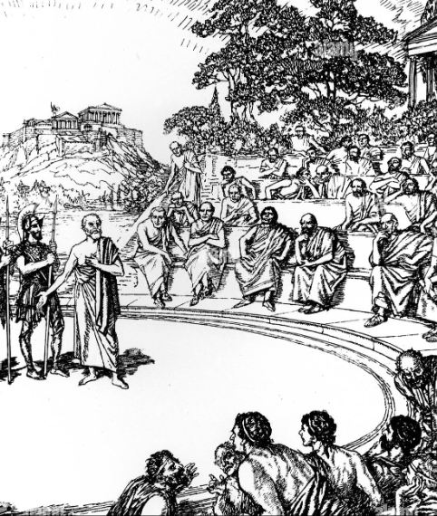
Krisis
The different meanings of the word in its original ancient Greek usage:
decision, determination, judgment
trial, sentence, accusation
quarrel, dispute
turning point or decisive point of disease progression

Slide 4

Cambridge Dictionary definition of “crisis”, 2022
= today’s understanding of the word
a time of great disagreement, confusion, or suffering
an extremely difficult or dangerous point in a situation

Slide 5
1. Crises have only an apparent beginning / end
“Beginning”
the root causes and events leading to a given “crisis” usually long predate it.
The same logic applies for the apparent “end” of a crisis.
The political, societal, cultural, and other sequelae of a crisis are often broader than our understanding of it, and only years or decades hence become visible to historians.

Slide 6
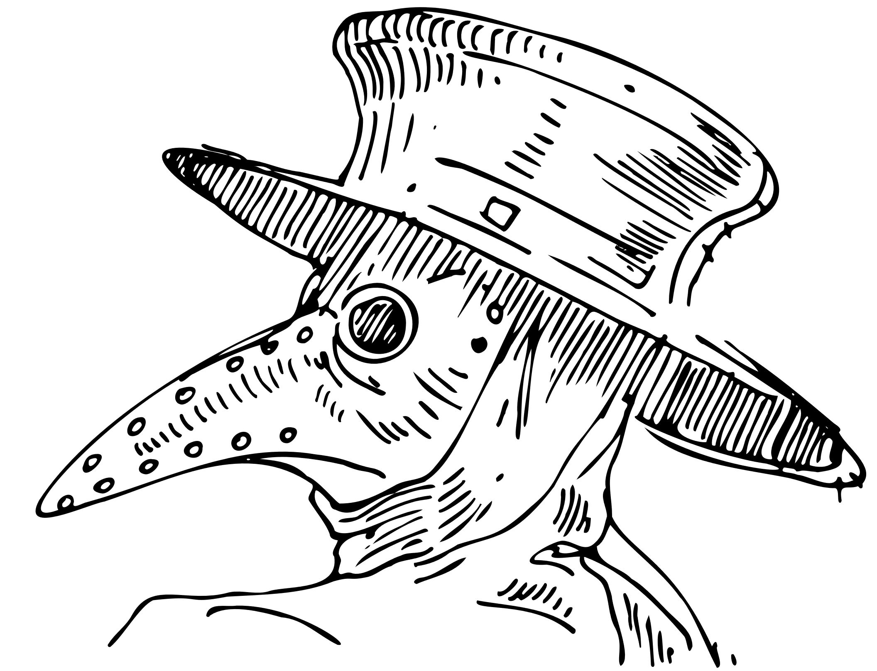
The Great Plague:
European population catastrophe
14th-15th century
Followed by profound societal change that led to the abolition of serfdom, creation of civic society (middle classes)
Notes:
France ha lost Up to 37% of ist population and even in the middle of the 16th century the population of France was less than its level in the early 14th century.

Slide 7
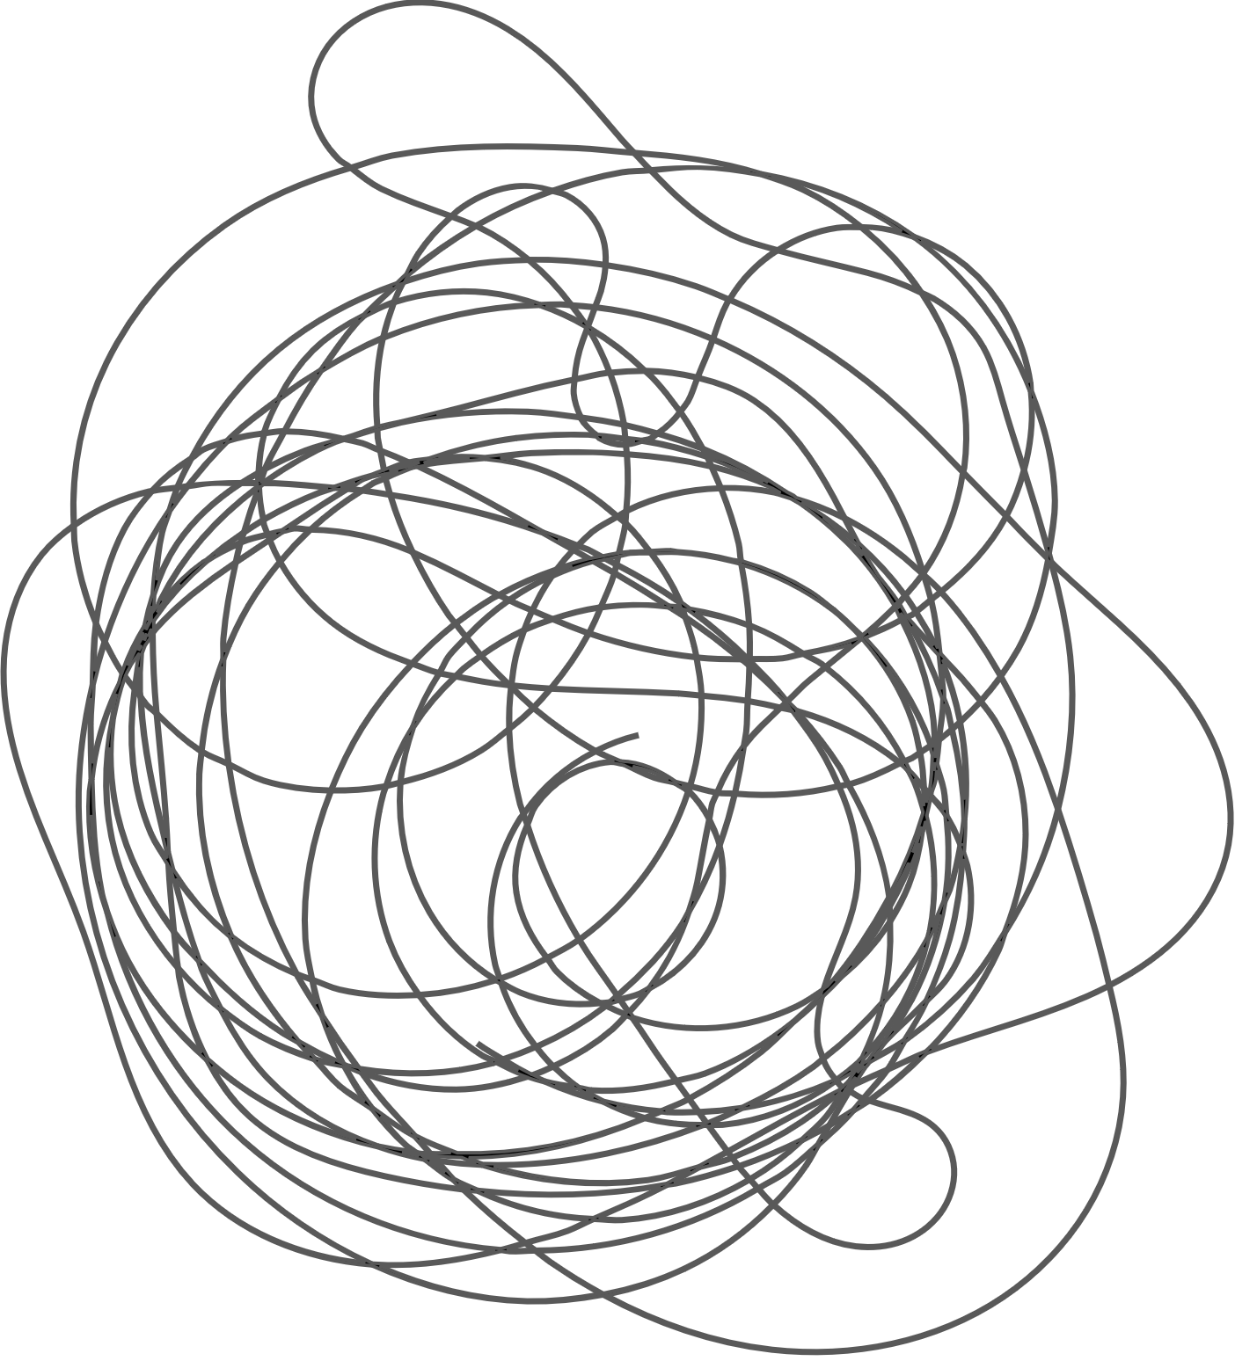
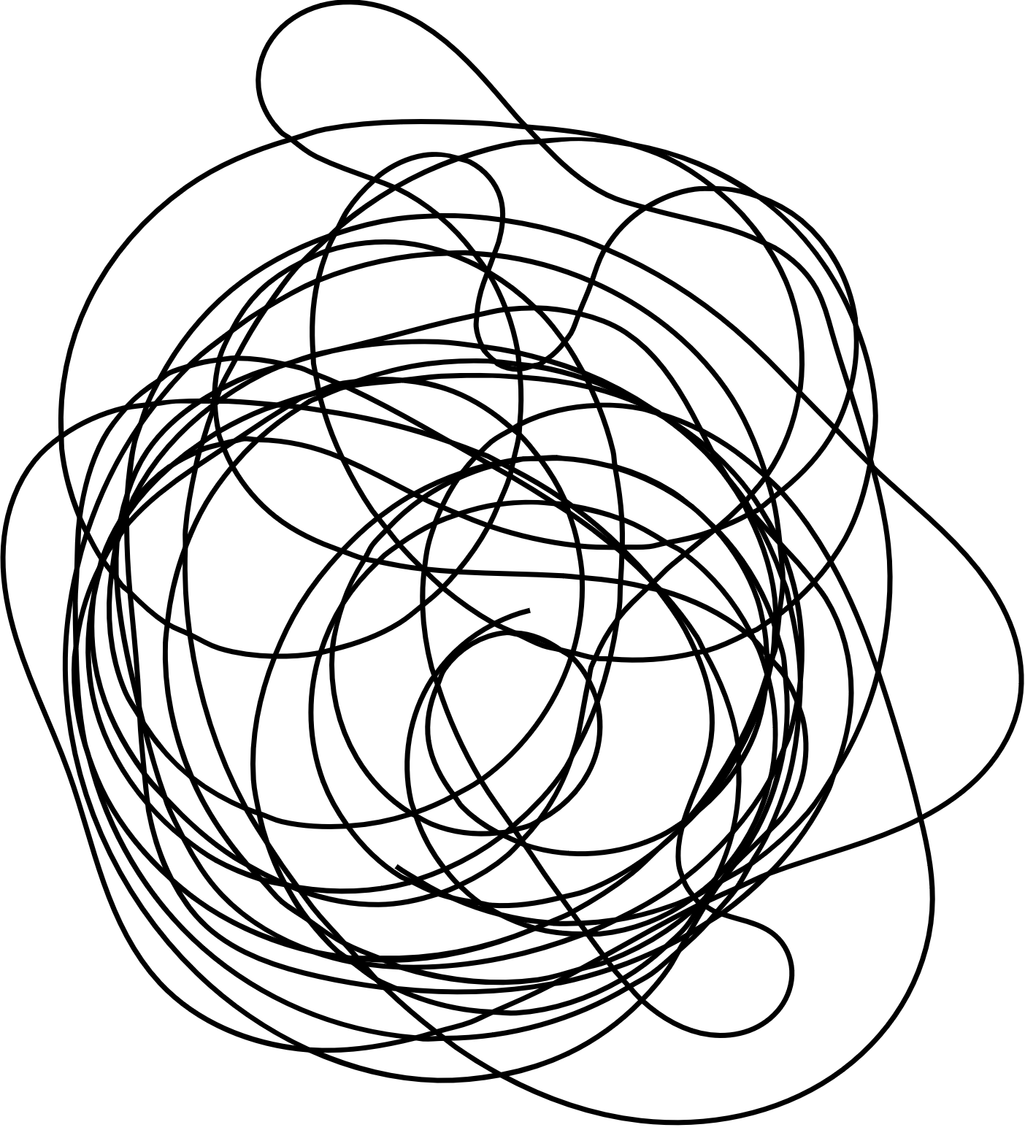
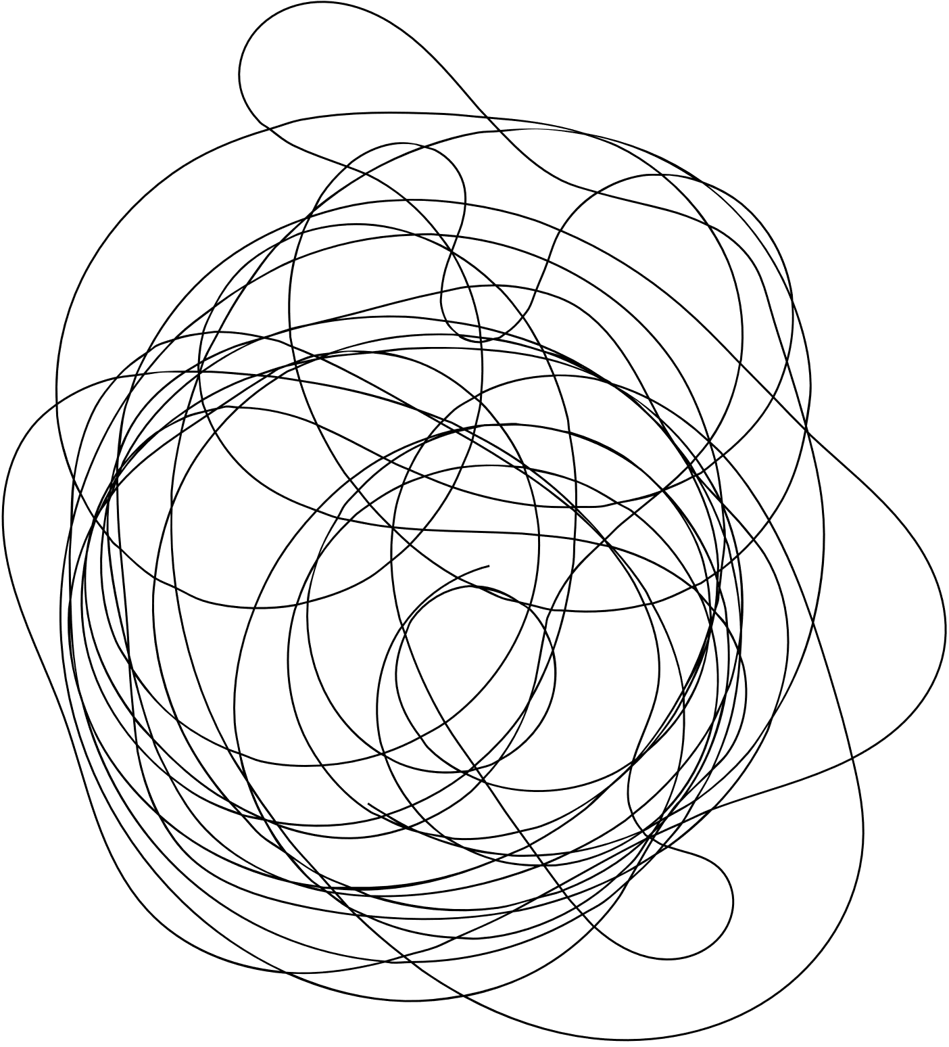
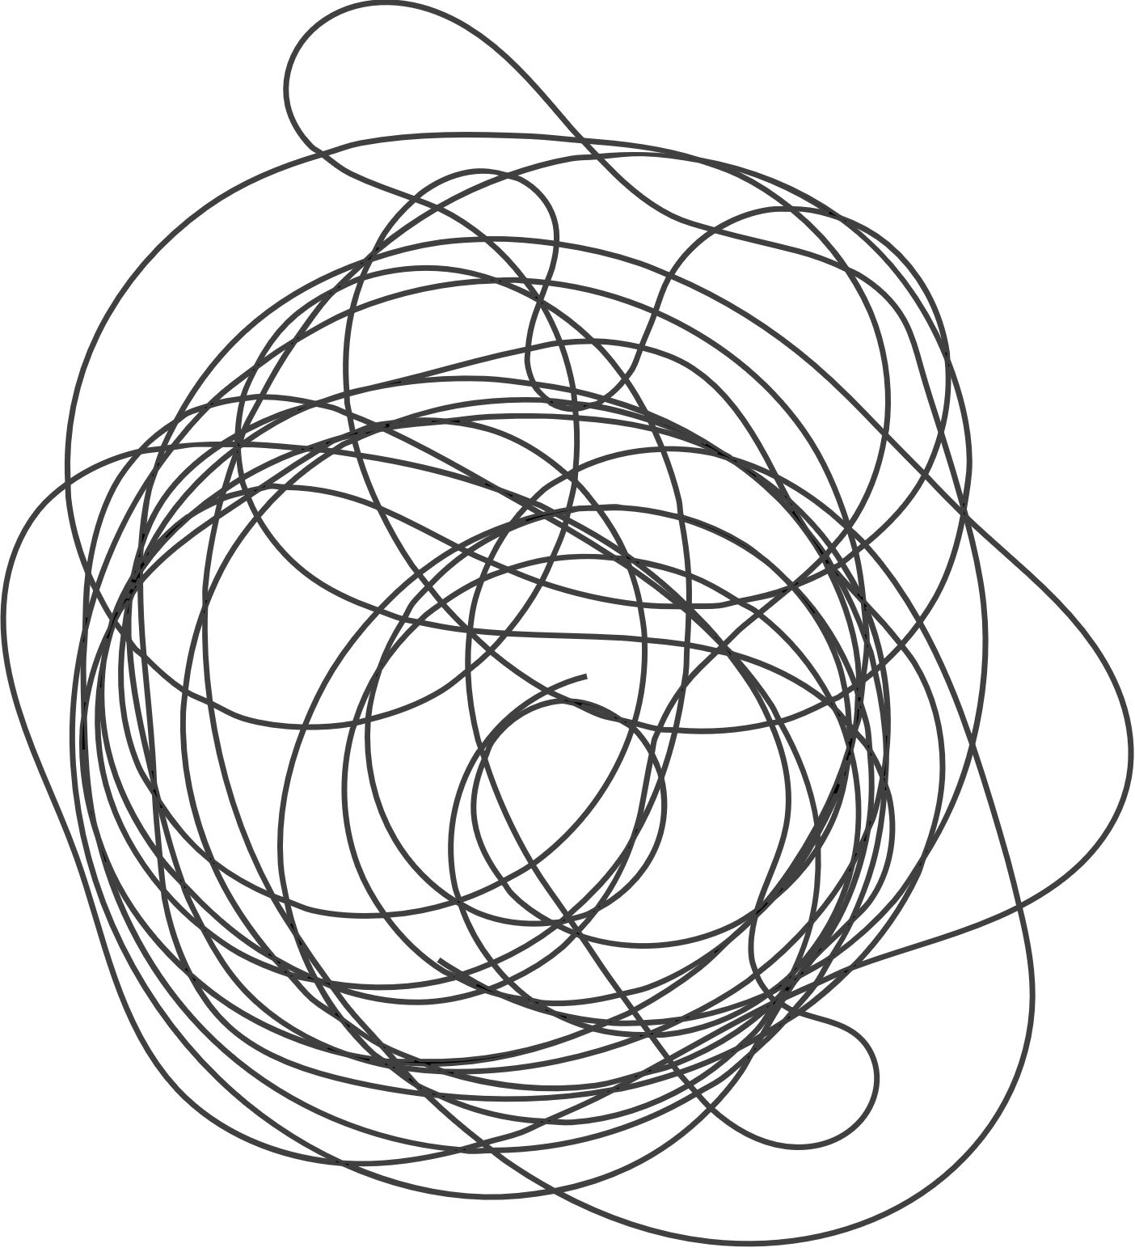

2. Crises frequently occur simultaneously
Example: the year 1961
wars raged in Angola, Eritrea, and Vietnam to name a few;
the Berlin wall was under construction;
the USSR was testing nuclear weapons; Yuri Gagarin became the first man in space;
Fidel Castro declared Cuba a socialist state;
the cold war was at its hottest phase, with a 3rd world war in easy reach of imagination.

Slide 8
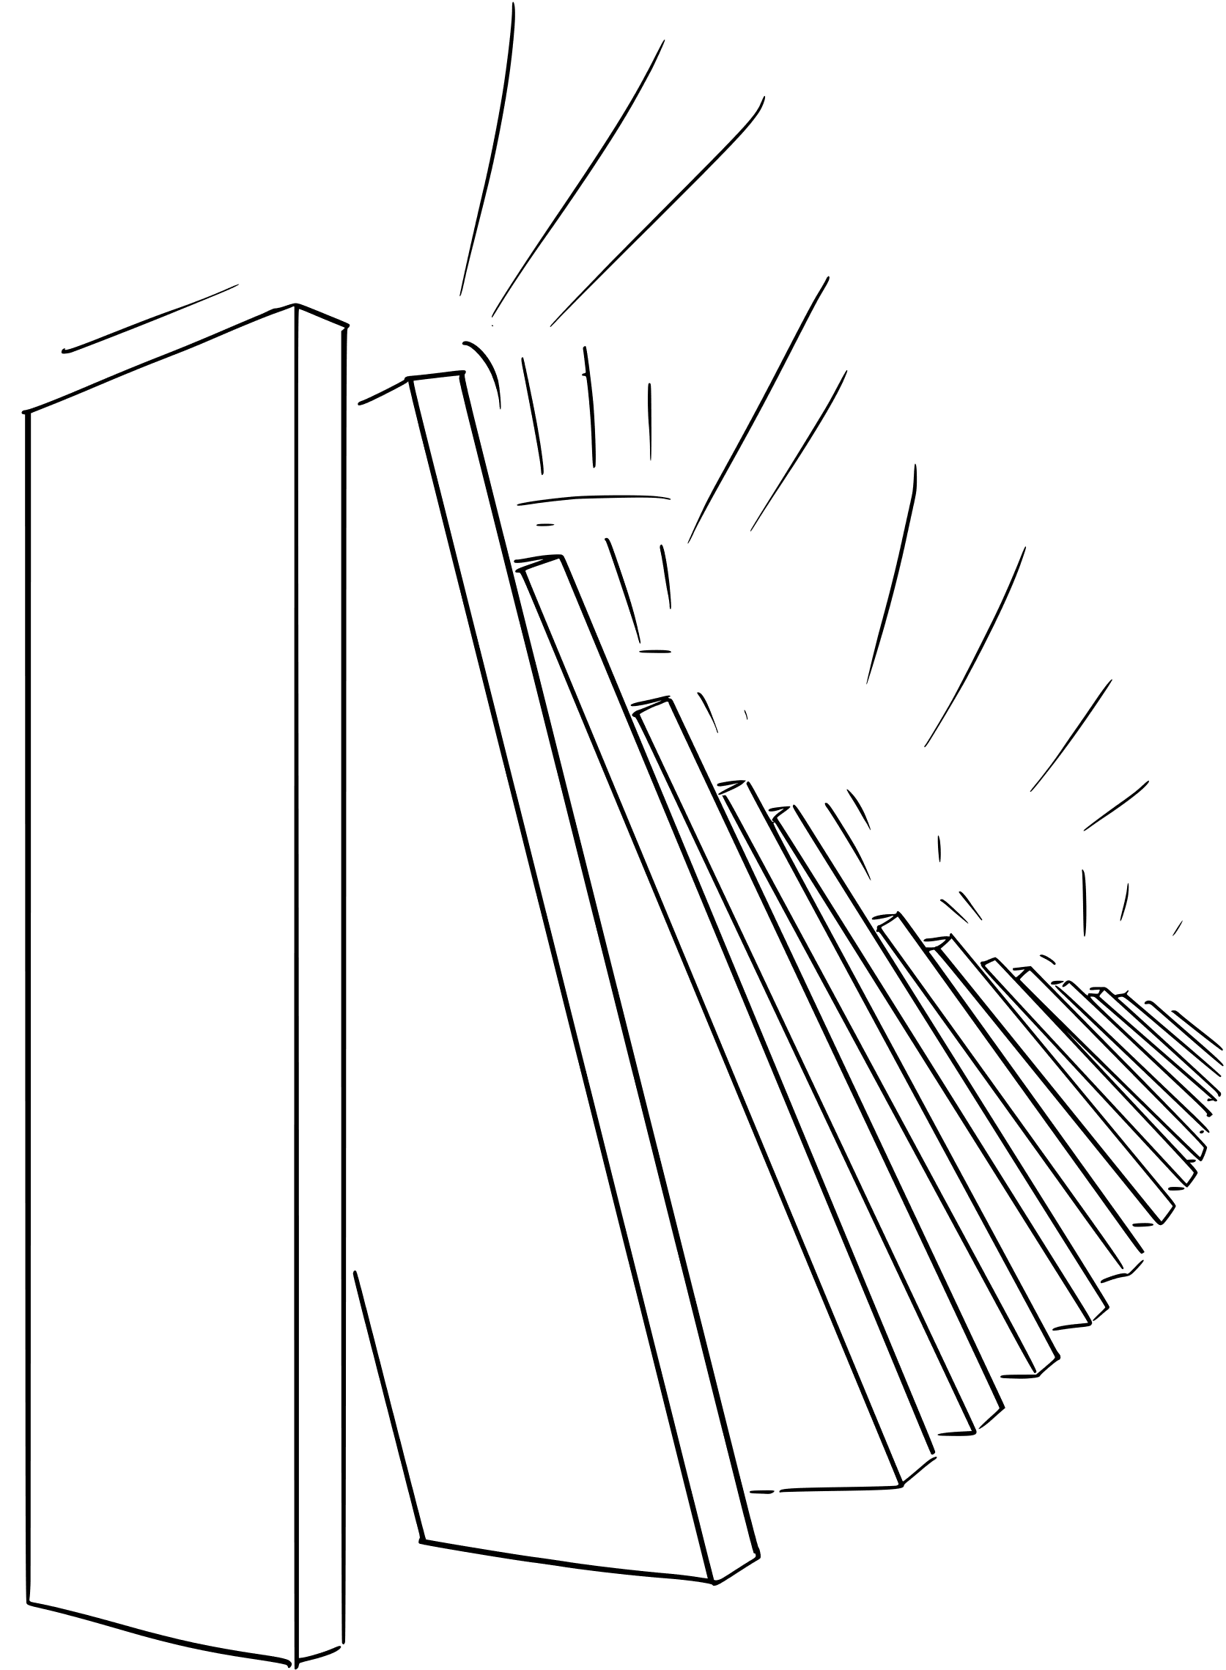
3. Crises are coinciding
One crisis may coincide with another and so amplifying the effects of both and creating new, complex, and deleterious dynamics.
The nexus of climate change and COVID-19 exemplifies such syndemic crises.

Slide 9
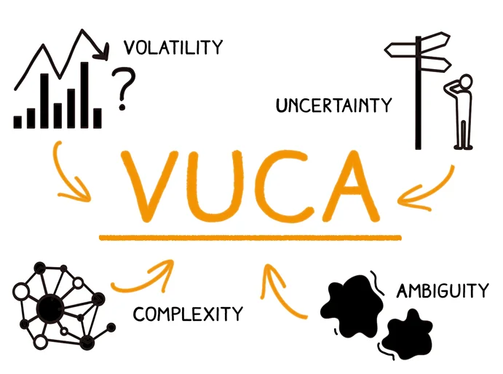

Slide 10
VUCA
Warren Gamaliel Bennis (March 8, 1925 – July 31, 2014) was an American scholar, organizational consultant and author, widely regarded as a pioneer of the contemporary field of Leadership studies. He proposed the VUCA concept in 1987.

Slide 11
VUCA
V = Volatility: the nature and dynamics of change, and the nature and speed of change forces and change catalysts.
U = Uncertainty: the lack of predictability, the prospects for surprise, and the sense of awareness and understanding of issues and events.
C = Complexity: the multiplex of forces, the confounding of issues, no cause-and-effect chain and confusion that surrounds organization.
A = Ambiguity: the haziness of reality, the potential for misreads, and the mixed meanings of conditions; cause-and-effect confusion.

Slide 12



“Handling” crises?
“Handling” crises one after the other is not an effective long-term strategy.
Nor is the often stated goal of getting “back to normal.”
Moving back to an earlier “normal” time is simply not possible
“Normal” -- when we attempt to define it -- turns out to be a constantly changing value.
The belief that we can deal with and resolve crises one by one is an illusion.

Slide 13
Living with crises?
Everyone will have to adapt to some facts: change is continuous, there is not a single moment, a single crisis, and there is no single rescuer. Even if these facts may be frightening in the first place, adapting the active attitude is salutary at the long run.
Flexibility and adaptability must be central to effective crisis response – this holds true at the individual and societal levels. For the individual this is a permanent learning process.
For the international community the challenge is far more complex.

Slide 14


The Pandemic Treaty negotiations as example
Any future treaty or global instrument must have inbuilt flexibility, as well as a mechanism that allows for the adaptation of its regulations as times and circumstances evolve.
Only flexibility and the ability to adapt can guarantee stability.

Slide 15
VUCA 2.0 Anticipate the Issues
VUCA translated into our times – the existence of several global challenges that are closely related and need:
Systems thinking Appreciate the Interdependence of Variables
Vision/Courage Interpret and Address Relevant Opportunities
Understanding the Consequences of Issues and Actions
Adaptability Prepare for Alternative Realities and Challenges

Slide 16

Leadership in today’s VUCA times:
Work of the Leadership Collective, October 2022
Meaningful, sustainable, solidarity-style leadership that enables us to move beyond existing world paradigms.
We are standing at the doorstep of opportunity to redefine leadership and promote a new leadership model.

Slide 17
The skills for new leadership:
”Job description”
The ability to travel beyond your own worldview and the skill to incorporate those learnings and awareness into your leadership.
Willingness to experiment with new tactics and approaches, including collaborative leadership structures, and create space and opportunity for others to do so.
Courage to acknowledge failure and receive feedback, and lead with new awareness.
The ability to be public-spirited and community-minded with a demonstrated commitment to truth, reconciliation and equity.
Notes:
A lot of today’s male leaders will not fit this job description

Slide 18

What to do now?
We must abandon the current modus operandi of approaching crises as discrete events with discrete solutions,
and instead embrace
diversity of thought, flexibility, and adaptability as leading principles
with a new leadership
in responding to complex and interlinked (in both time and space) global challenges.
Notes:
A new leadership with skills and to shift power from groups and structures whose exploitive practices have delivered a world where deep inequities are destroying trust, fracturing communities and undermining democracy

Slide 19
Should we still talk about Crisis?
if we understand the term in its positive, proactive way,
in the ancient Greek meaning, it can be used.
What we have to be aware though is the flow of events that we are part of and actors in the same time.

Slide 20
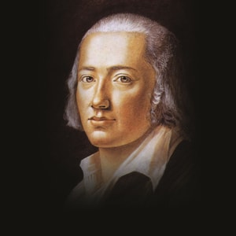
“where danger is there the saving powers will grow as well”
Friedrich Hölderlin, German Poet, 1770-1843

