Slide 1
International Organizations market & secrets
Dr. Manuela Morelli
Founder, Talentum Consulting

Slide 2




International Organizations:
Your contribution
“Make the world a better and safer place for future generations”
(M. Stanley, 2007)

Slide 3
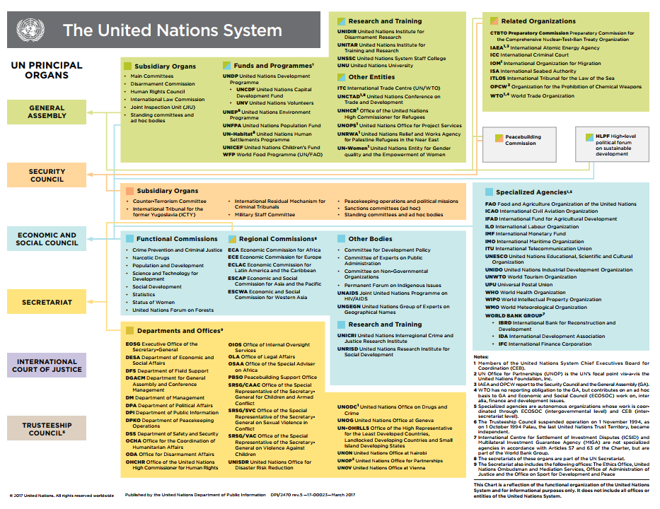
The UN system
General Assembly
UNDP, UNEP,UNSSC,
etc.
Secretariat
OCHA, OHCHR, UNOG
etc.
International Court of Justice
Security Council
ICTR, ICTY
etc.
Economic and Social Council
FAO, ITU, UNESCO,
etc.
Trusteeship Council
UN

Slide 4

UN 2030 Agenda for Sustainable Development
MDGs or SDGs? What changed?

Slide 5
International Civil Servant
Independent international civil service known for its high standards of ethics, fairness, transparency and accountability;
Truly integrated, field-oriented organization;
Multi-skilled, versatile and mobile staff working across disciplines.
Manuela Morelli
Career Coaching
Notes:
Employees of United Nations are defined “International Civil Servant”.
The definition of an international civil servant was proposed by the by the Secretary General in 2008 and gives you an idea of the comptences, skills and level of commitment and integrity that is required to work for United Nations.

Slide 6

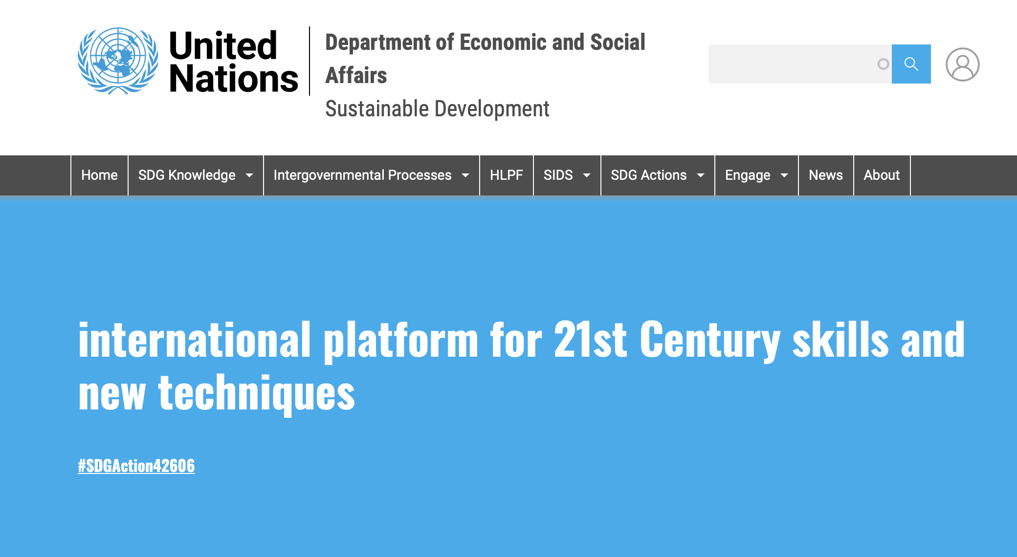

Slide 7
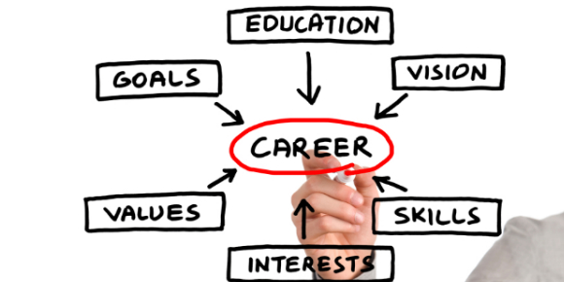
Career Mapping

Slide 8


UN Competency Framework
“It is my hope that competencies will provide us with shared language for talking, in concrete terms, about high performance and managerial excellence. I believe that a shared view of the standards we are striving to achieve will assist us in our continuing efforts to prepare the Organization to meet the challenges of the 21st century.”
---Kofi Annan

Slide 9
TALENT FOR PEOPLE
Career Coaching for Young Professional and Mid-Senior in Career Transitions (individual, group)
Career Coaching Career talks, workshops, seminars
Group Coaching (Action Learning, Peer to Peer Coaching)
CV and motivation letter writing
Competency assessments and Job market analysis, Networking and personal branding
Career Counselling
ICF Certified – Individual and Team Coaching

Slide 10

UN Pathways
Internships
Consultancy
Young Talent Programmes
Staff

Slide 11
Talent Programmes Requirements
Y/JPP (Young/ Junior Professional Programme), NETI (New Emerging Talent Initiative)
A minimum of two years of paid working experience in a relevant field.
Usually be under 32 years of age;
Academic qualifications: Master's degree (or equivalent) in a development-related discipline;
Language skills: written and spoken proficiency in: English or French. Fluency in Arabic, Chinese, Spanish, Russian or Portuguese is an asset;

Slide 12
Talentum Consulting
Unlock Organizations and People’s Talent
Want to prepare your Talent Development Plan? contact@talentum-consulting.net

