Slide 1



  Vaccine Logistics:
  Tracking and Monitoring of
  Vaccine Transport Units on the “last mile”
  Prototype / POC
  October 2022
  Coll MacDougall-Hunter
  Uwe Winnwa
  Brief Overview

Slide 2

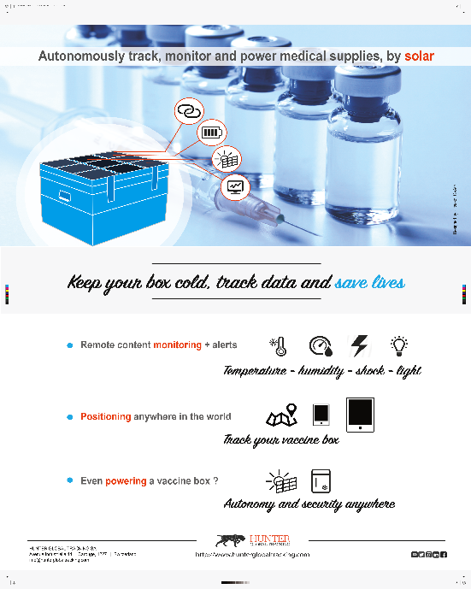


Initial idea - WHO 15th TechNet Conference 2017
Initial poster
presented by
Coll MacDougall-Hunter
at
WHO 15th TechNet Conference,
Cascais, October 2017

Slide 3

STS from Vision to Mission 1/2
Become the extended workbench for global healthcare organisations,
helping them to gain transparency, improve efficiency and drive innovation, independent from any manufacturer, especially on the ‘last mile’, in LMICs.
  Because, despite quite remarkable progress in cold chain logistics over the past years, especially during the current Covid crisis – it very frequently stops at the final distribution centre before embarking on the ‘last mile’ where modern couriers cease operating and other more rudimentary means take over (human, donkey, bicycle, drone, SUV ), and in very difficult conditions:
a DHL/McKinsey report (Revisiting Resilience, May 2021): “large parts of Africa, South America and Asia might not even see vaccines (especially COVID) being readily supplied due to the unavailability of cold-chain logistics, mainly on the last transport leg”.
Abstract from “Cold Chain Logistics Market for Vaccines: Industry Trends & Global Forecasts”: ReportLinker, (February 2021): “25% of vaccines are damaged due to cold chain malfunction; (….) in some countries, around 80% of the drugs are estimated to lose their potency due to inadequate temperature control during their cold chain transportation. Moreover, connected cold chain solutions have been observed to offer variety of advantages over conventional methodologies, such as automation of most of the steps and elimination of human handling errors that are associated with human intervention”.

Slide 4
STS from Vision to Mission 1/2
Hence the rationale behind this proposal:
• On the global demand side:
In their joint Press Release of 15 July 2022, WHO & UNICEF sounded the alarm as new data show global vaccination coverage continued to decline in 2021, with 25 million infants missing out on lifesaving vaccine:
“This is the largest sustained decline in childhood vaccinations in approximately 30 years.”
  “ …. This decline was due to many factors, one of which was COVID-19 related issues such as service and supply chain disruptions…..
  …..WHO & UNICEF are working with GAVI, the Vaccine Alliance and other partners to deliver the Global Immunization Agenda (IA2030), a strategy for all countries and relevant global partners to achieve set goals on preventing diseases through immunization and delivering vaccines to everyone, everywhere, at every age.
  IA2030 partners call on … relevant actors to:
    expand outreach services in underserved areas ….
    prioritize health information systems, to provide the data and monitoring needed for programme impact
    leverage and increase investment in research to develop and improve … immunization services.”

Slide 5
What to do, why, where, when & how?
    What: progressively improve ‘last mile’ vaccine distribution with novel technologies.
    Why: to reduce waste, inefficient deliveries, theft, fraud…
    Where: on the “last mile” – often many miles in tough environments!
    When: Now, thro’ Swiss Tracking Services (STS), in NE.
    How: 2 parallel simultaneous tracks:
              Upgrade existing shipment/box tracking by:
                launching basic labelling/tracking system on ‘invisible/dumb’ boxes (latest-technology partners already identified/associated)
                then status monitoring by progressively introducing increasingly intelligent IoT labelling etc (idem)
              Build & test self-refrigerating/autonomous and IoT smart Cold Box/vaccine carrier, powered by solar.

Slide 6
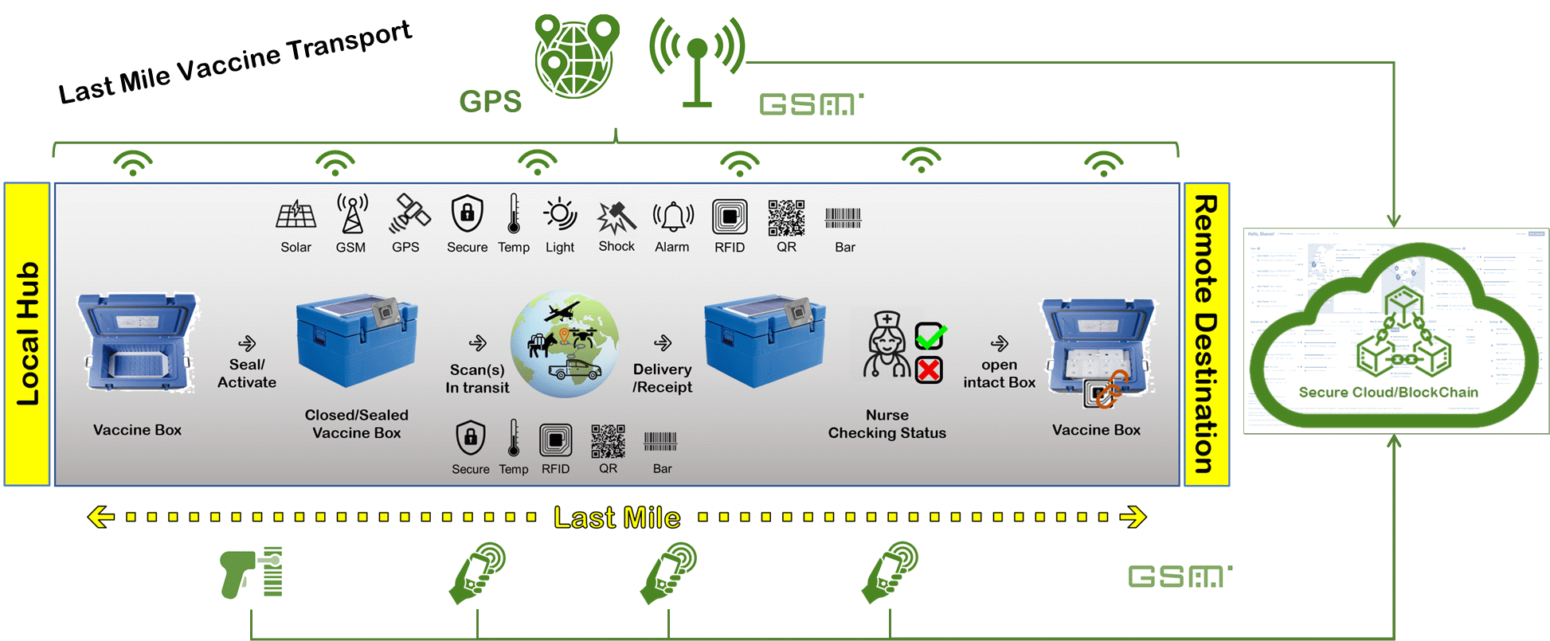
What is the challenge of the ‘last mile’ on LMICs?
➔ …. addressing the next generation of temperature controlled/cold chain Vaccine carriers/boxes

Slide 7

STS Key Components
  STS offer for the ‘last mile’ is based on 3 components:
  Software as a Service (SaaS) Data / Management Platform DHIS2 (OS: Uni Oslo)
      Inventory – Analytics – Position Information (Map) – Status – Alerts
  Smart Elements (middle ware)
      IoT (Internet of Things) Components and Sensors
      Smart: no longer ‘invisible’ or ‘deaf/dumb’ but ‘visible’ i.e., ‘hearing & talking’:
      Position information: IoT enabled by Solar power
      Status: data thanks to sensors, GPS, satellite …..
  Hardware / Trackable Items (Cold box & accessories)
      Autonomous: self-charging active boxes to produce enough power from solar and battery to refrigerate: temperature control @ 2-8°C
      Power: Solar, then combination of technologies (adsorption, tweaking Peltier, novel gel)
      Any other package, transport box etc.

Slide 8

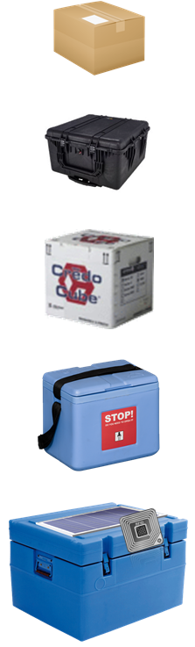
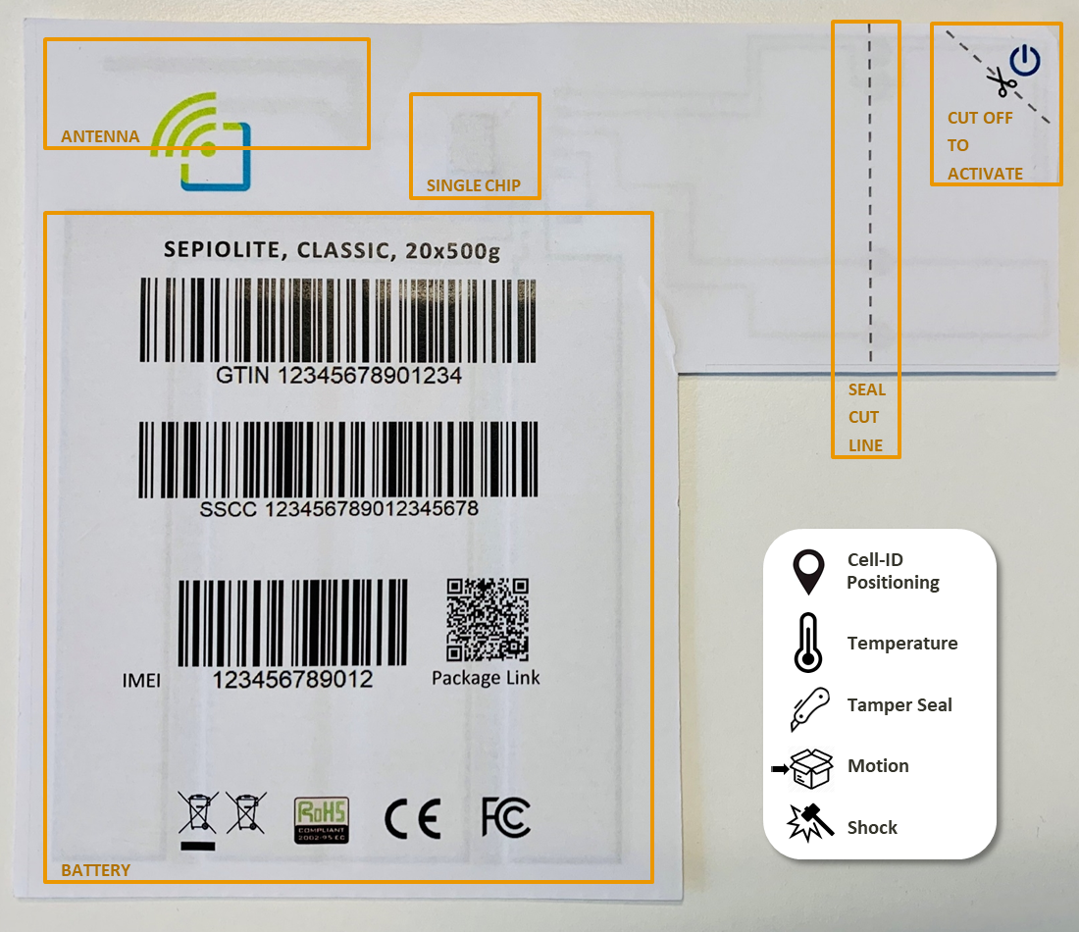

Summary of ‘last mile’ smart service offers
Proposed steps from Basic to Full: 1/4
how to progressively upgrade current and future vaccine carrier/box/package fleet(s)
  Level 1: Basic Smart: semi-connected carrier/box:
  Level 2: Intermediate Smart: label-connected Carrier
  Level 3: Fully Smart: autonomously-refrigerated and fully smart vaccine carrier/box
  ➔ 100% service offering: (Holy Grail “always online”)
Addressable Market:
  > 2 Million Vaccine Carriers (1.1 Million GAVI – 50% Market Share)
  > 25 Million Vaccine Transport Cases (approx. 13.4 Million GAVI)

Slide 9
Summary of Smart Service Offers
Proposed steps from Basic to Full: 2/4
how to progressively upgrade current and future vaccine carrier/box/package fleet(s)
  Level 1: Basic Smart: semi-connected carrier/box:
Data capture system + management platform to track & monitor, on the ‘last mile’, any small shipment for status, alerts, inventory and analytic purposes.
How?
By initially attaching inexpensive labels – readable with simple mobile phones (+ novel technologies + NFC, sensors, ….) to specifically know, at smart phone/reader consultation points, the whereabouts of current fleets of passive vaccine carriers/boxes/shipments, i.e., as a first step, convert them from being ‘invisible’ to ‘visible’, therefore transparent for logistics departments.

Slide 10
Summary of Smart Service Offers
Proposed steps from Basic to Full: 3/4
how to progressively upgrade current and future vaccine carrier/box/package fleet(s)
  Level 2: Intermediate Smart: label-connected Carrier:
Then progressively upgrade data capture by introducing more intelligent IoT ‘middle-ware’ :
sensors,
positioning,
communication … even in remote areas,
to enhance distribution performance and analytics on the targeted ‘last mile’ – still using simple and inexpensive technologies

Slide 11
Summary of Smart Service Offers
Proposed steps from Basic to Full: 4/4
how to progressively upgrade current and future vaccine carrier/box/package fleet(s)
  Level 3: Fully Smart +:
In parallel, develop a fully smart, autonomous solar-powered vaccine box:
  with tracking & positioning + alerting per GPS/GSM + ETAs
  highly intelligent sensors for constant content monitoring/lid opening, shock, temperature, humidity, etc.,
  solar-powered, with a long-life battery for a 2-8°C range of remote-controlled self-refrigeration,
  RFID, NFC labels.

Slide 12





STS product roadmap
Phase 2
Position
Timestamp
Status
Temperature
Phase 4
Position (GPS)
Timestamp
Status
Temperature
Sensors
Falcon
Buzzard
Q4/22
Q1/23
Q2/23
Q3/23
Q4/23
Phase 1
Position
Timestamp
Status
Phase 3
Position (Cell/tag)
Timestamp
Status
Temperature
Milestone
Refrigeration
Tracking
Sensors
Temperature
Monitoring.
Merlin
Hawk
Eagle

Slide 13
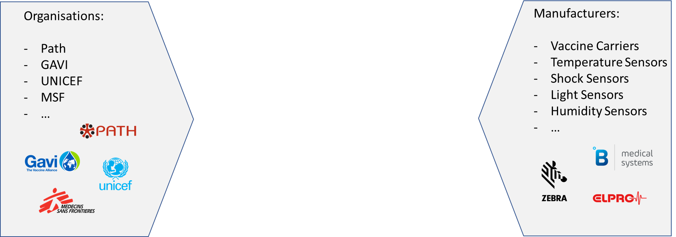
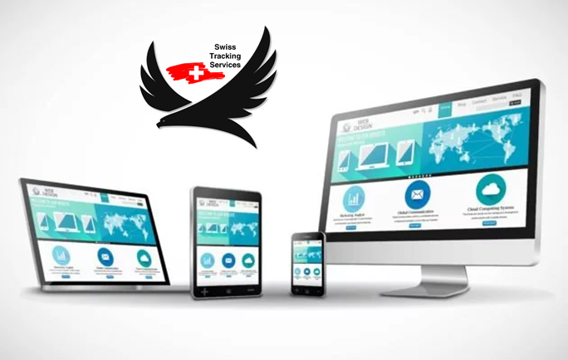





STS Service Proposition
Mobile / Satellite Network Operators

Slide 14
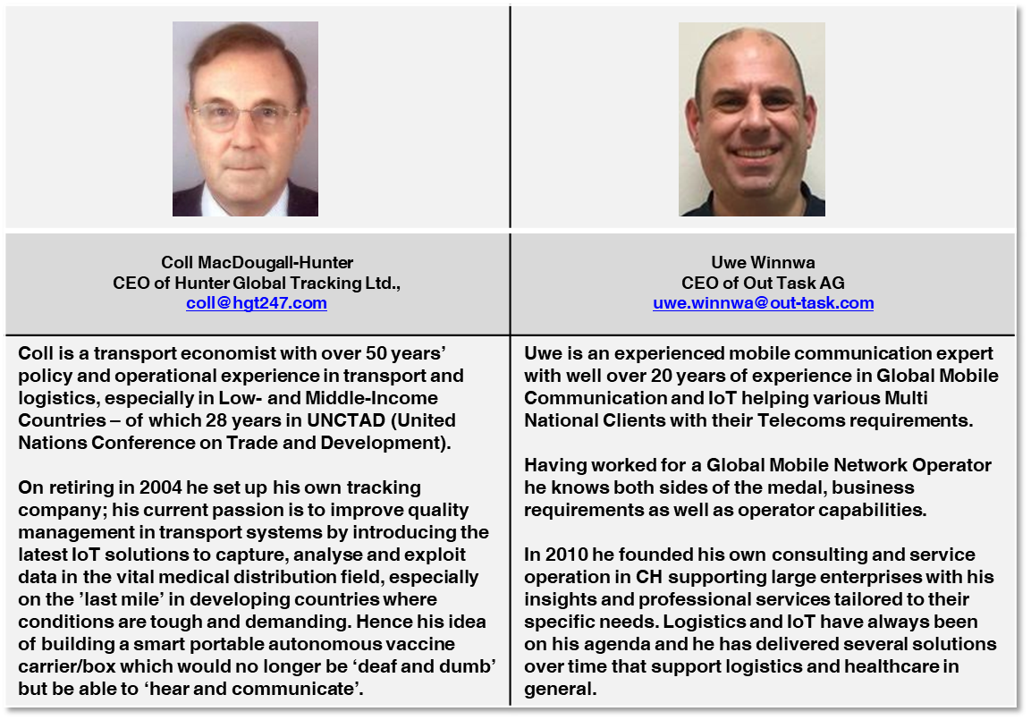
Who are we?

