Slide 1

Rotary’s PolioPlus Programme
October 2022

Slide 2
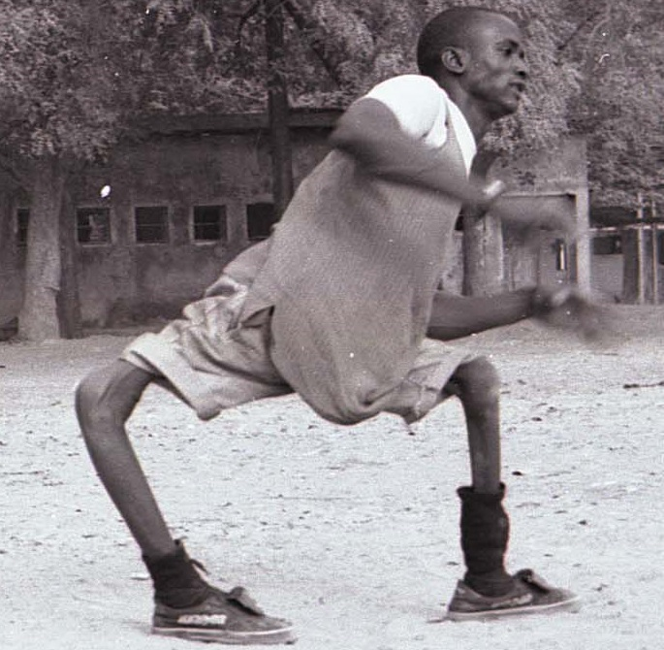
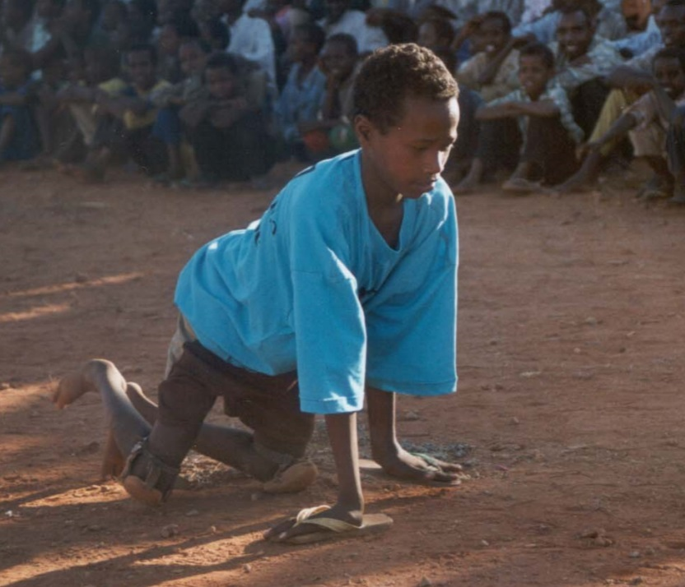
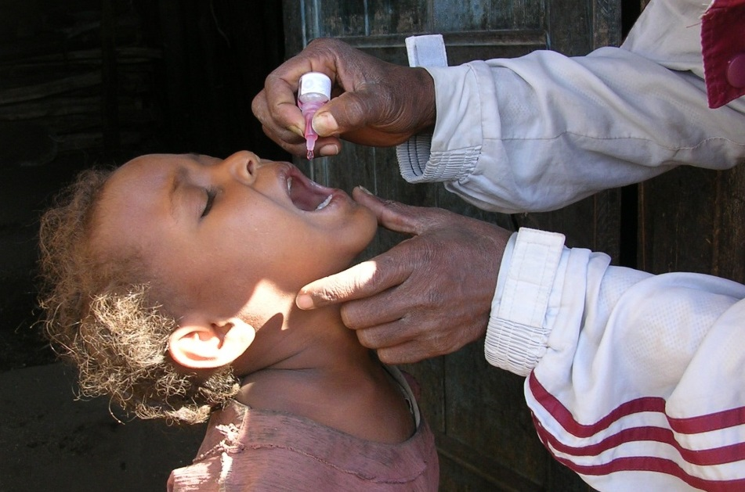
Polio
Lifelong paralysis
Children most at risk
Preventable thru vaccination

Slide 3
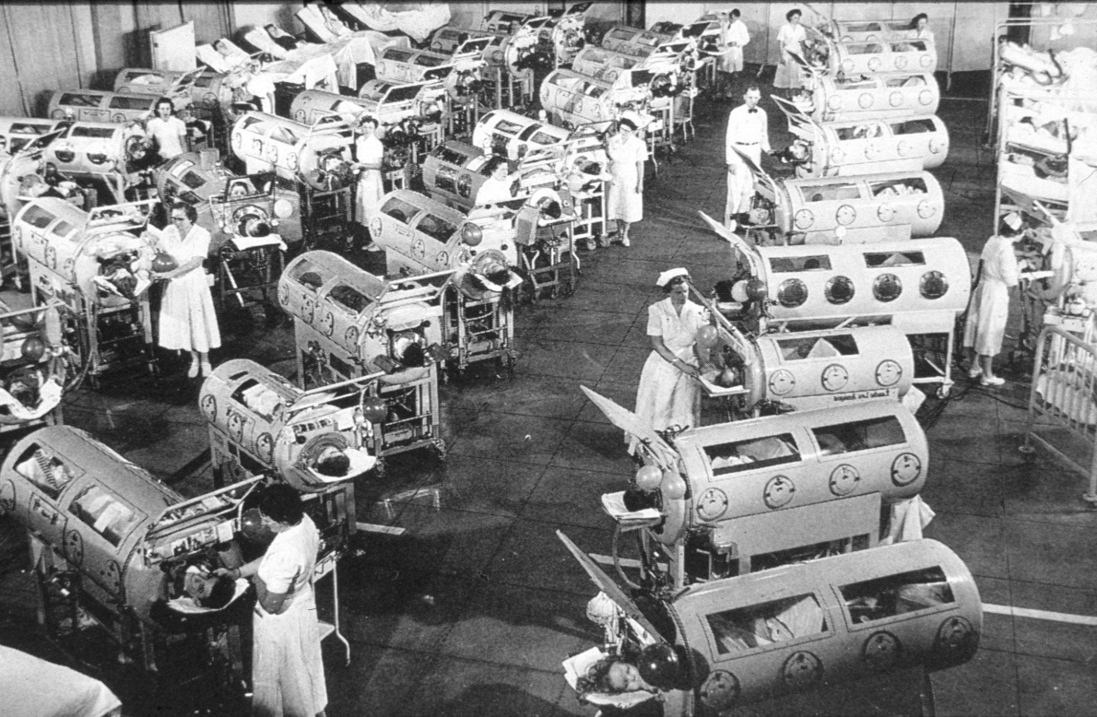
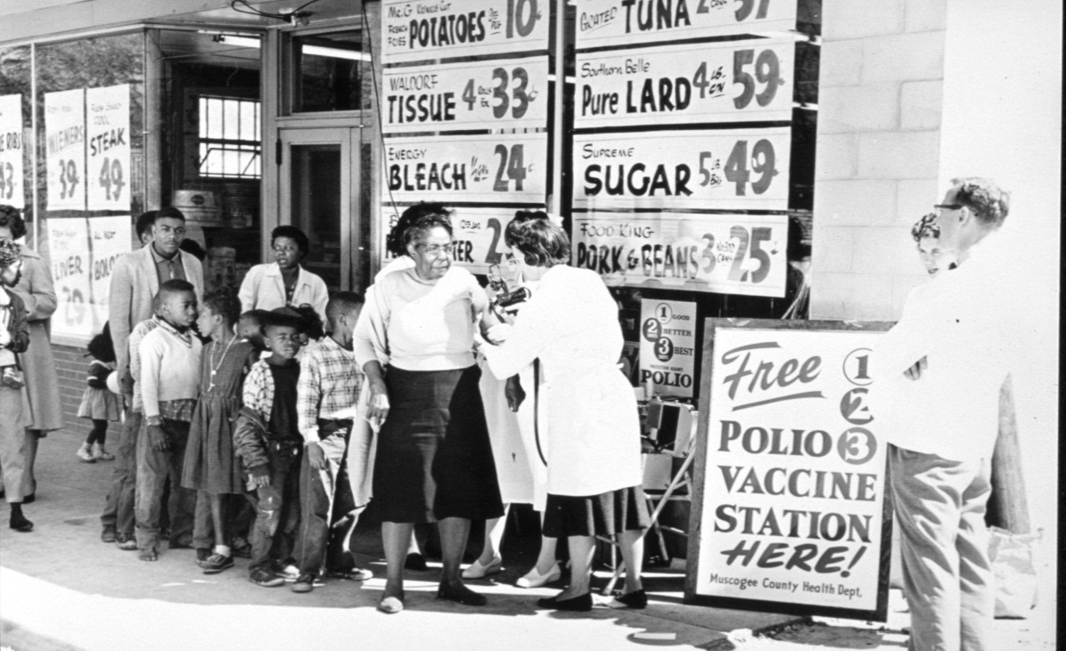
1955: first vaccines developed
Polio rapidly disappears from developed countries

Slide 4
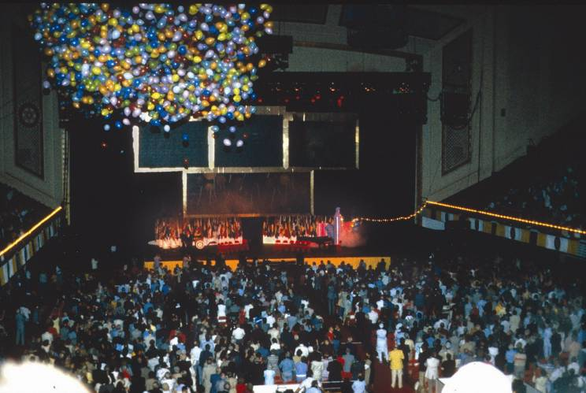

Launch of PolioPlus! Philadelphia, 1985

Slide 5





Many partners
help ensure success
Health ministries
Private
sector
20 million volunteers
NGOs
Media
Donors
(governments, development banks, private foundations, etc)

Slide 6
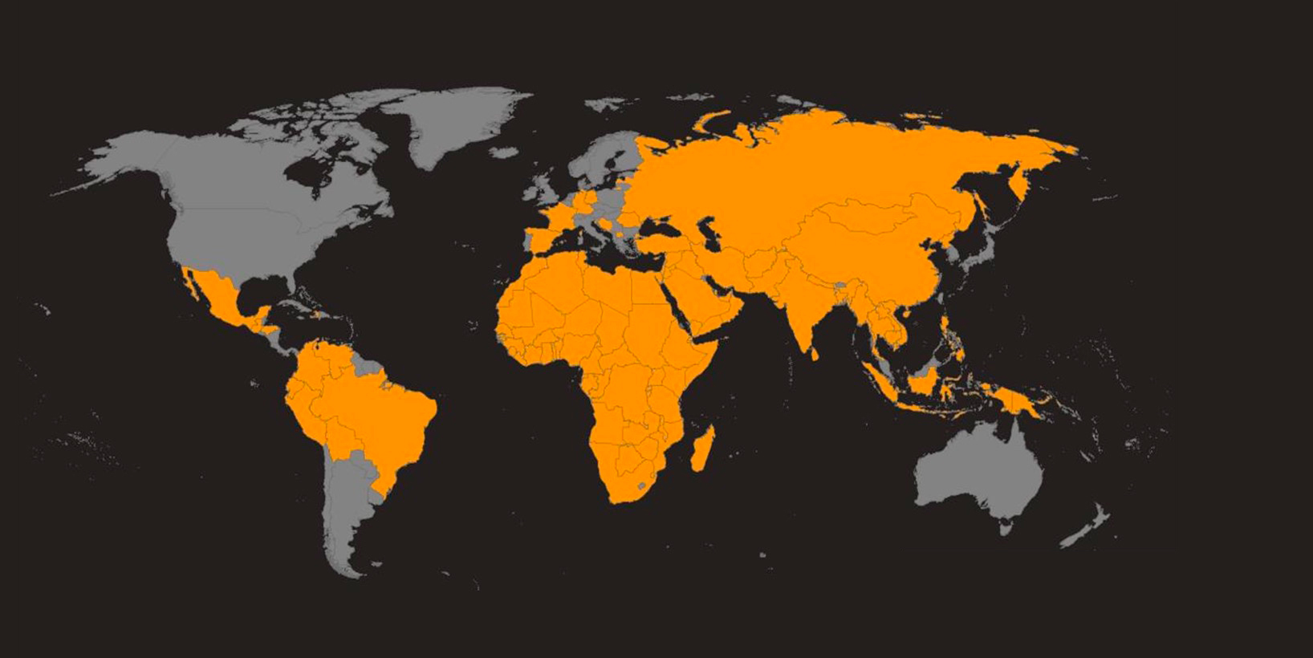
1988
Wild poliovirus endemic in
125 countries

Slide 7
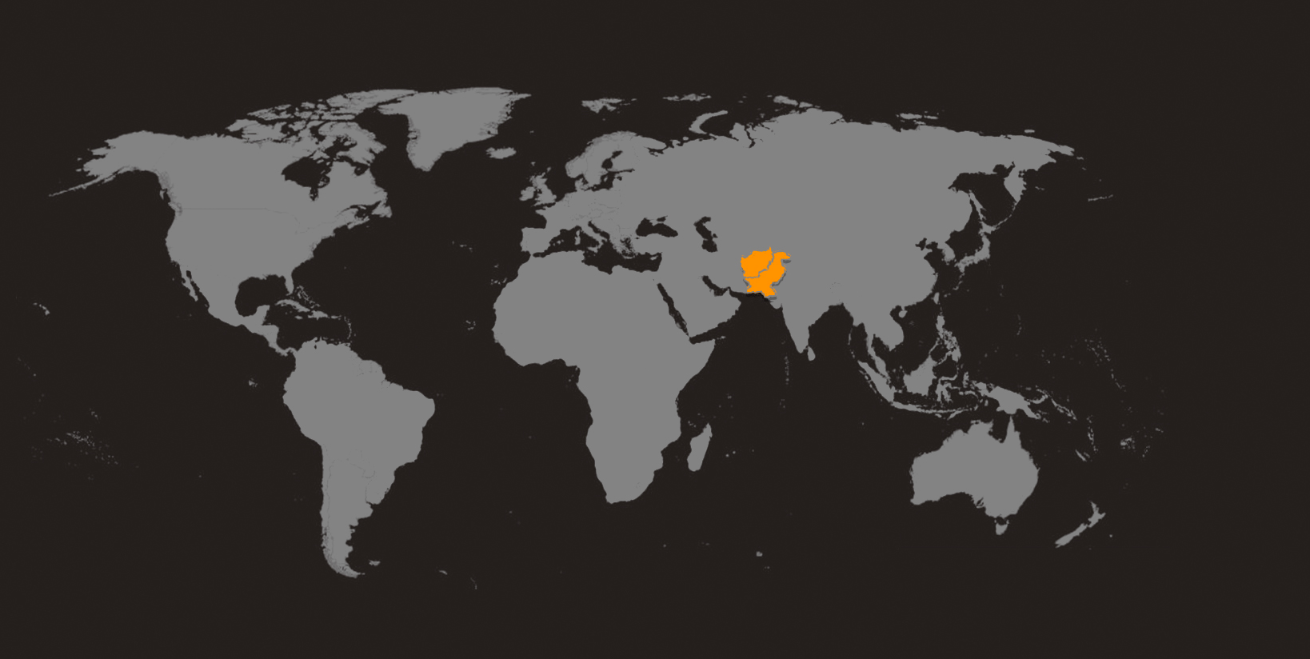
2022
2 endemic countries

Slide 8
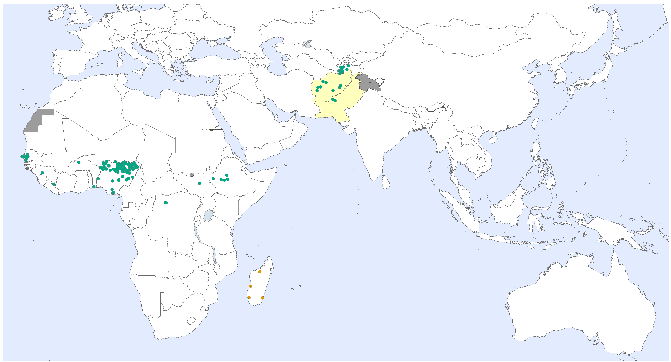
WPV and cVDPV cases
last 6 months

Slide 9
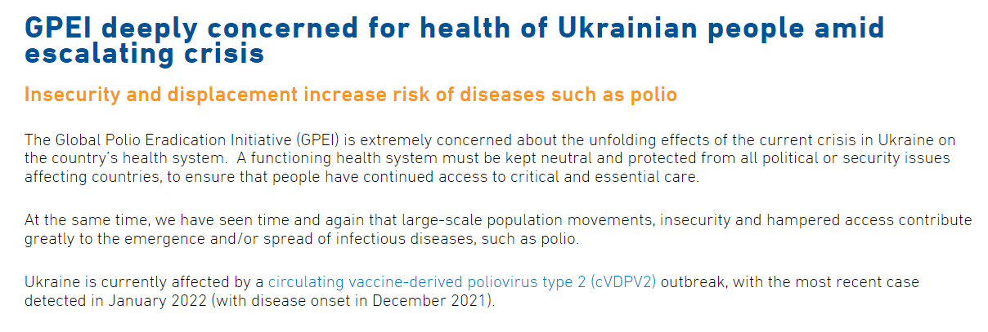
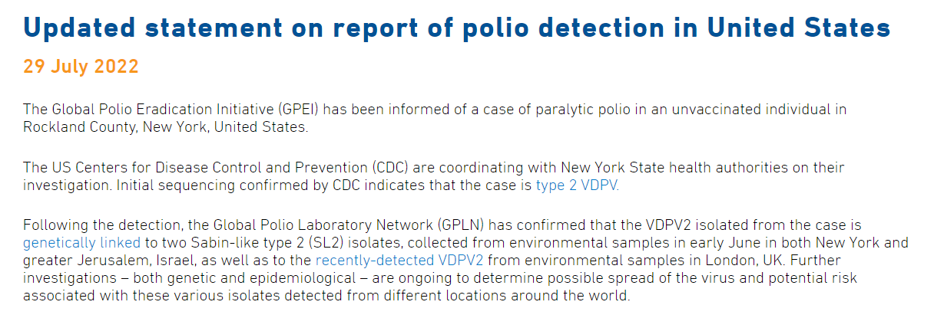
Polio in Ukraine, England, USA, Israel

Slide 10
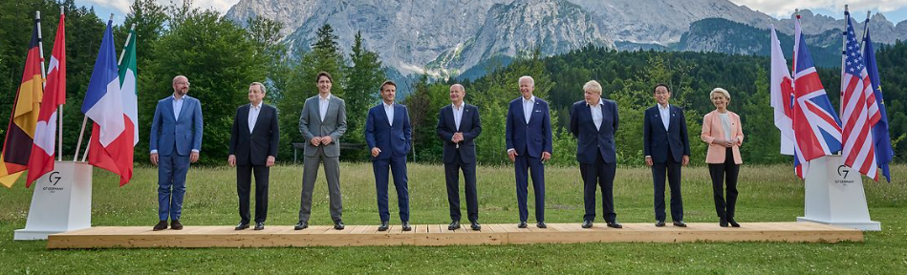
Global commitment
WHA
Rotary Convention, Houston, TX
G20 Health/Development Ministers
G7 Leaders
Commonwealth Heads of Government

Slide 11
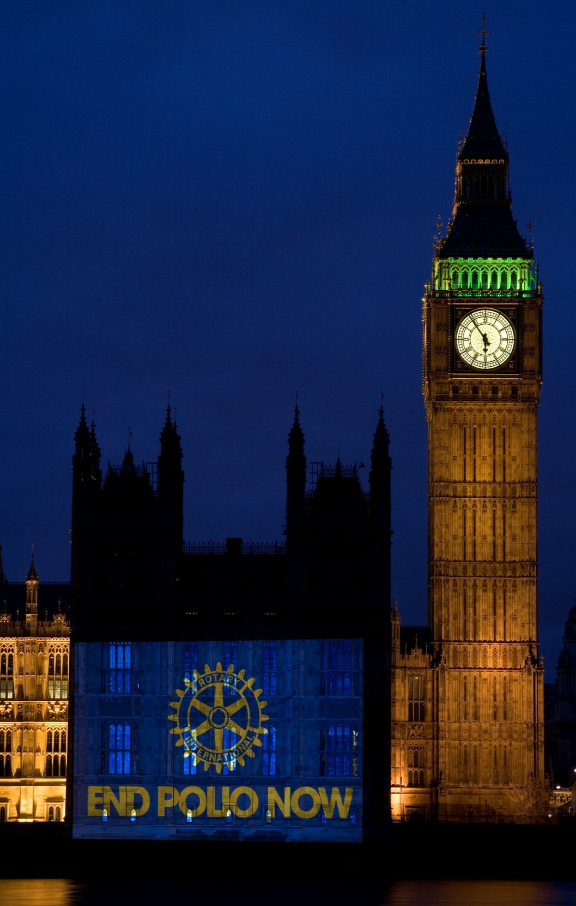
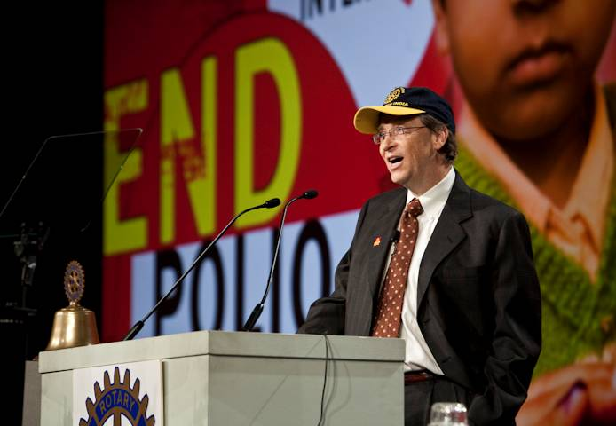
"Rotary is the heart and soul of polio eradication!"
Bill Gates

Slide 12

Rotary’s promise: a world without polio
Rotary first with vision of polio-free world
More than US$2.7 billion raised by Rotarians personally
More than US$10 billion in public funds secured thanks to Rotary’s advocacy efforts

Slide 13
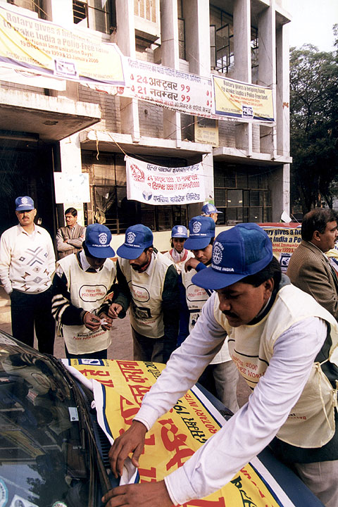
Rotarians engage communities

Slide 14
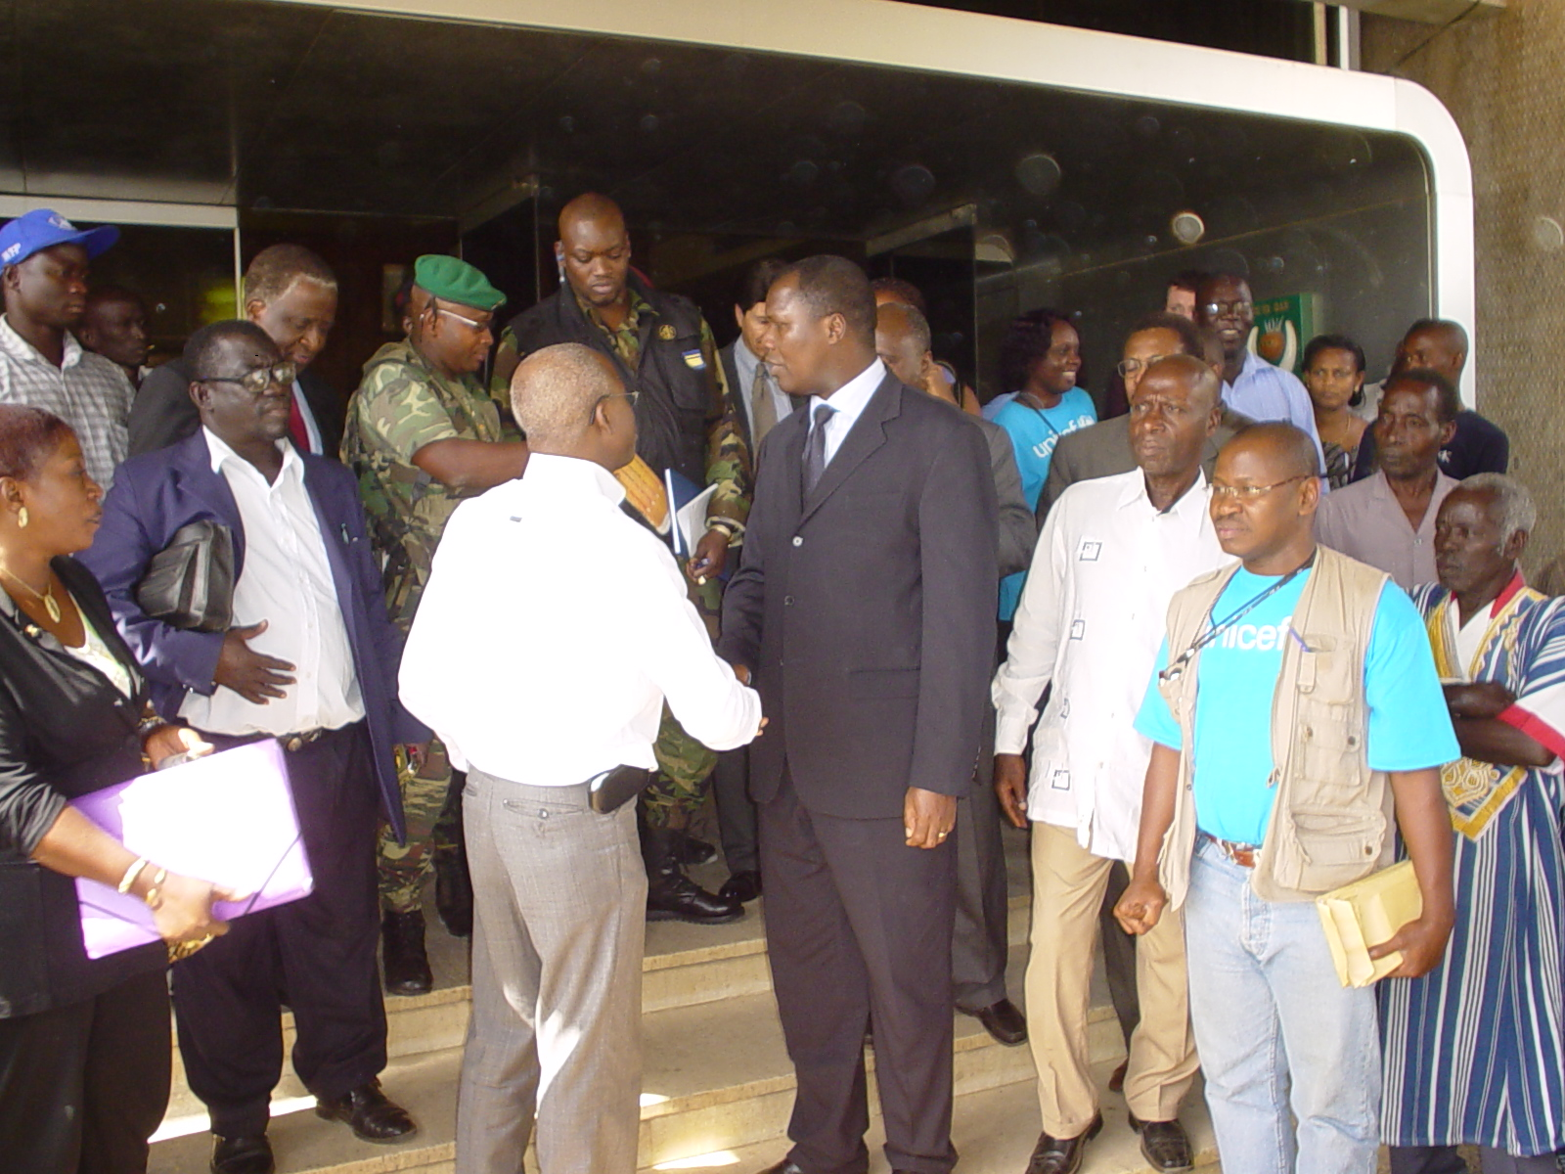
Rotary: bringing peace
Rotary/UN peace negotations:
Cote d’Ivoire, February 2005

Slide 15

Thanks to PolioPlus
>20 million cases averted
>1.5 million lives saved
>20 million volunteers mobilised
>400 million children vaccinated (every year)

Slide 16
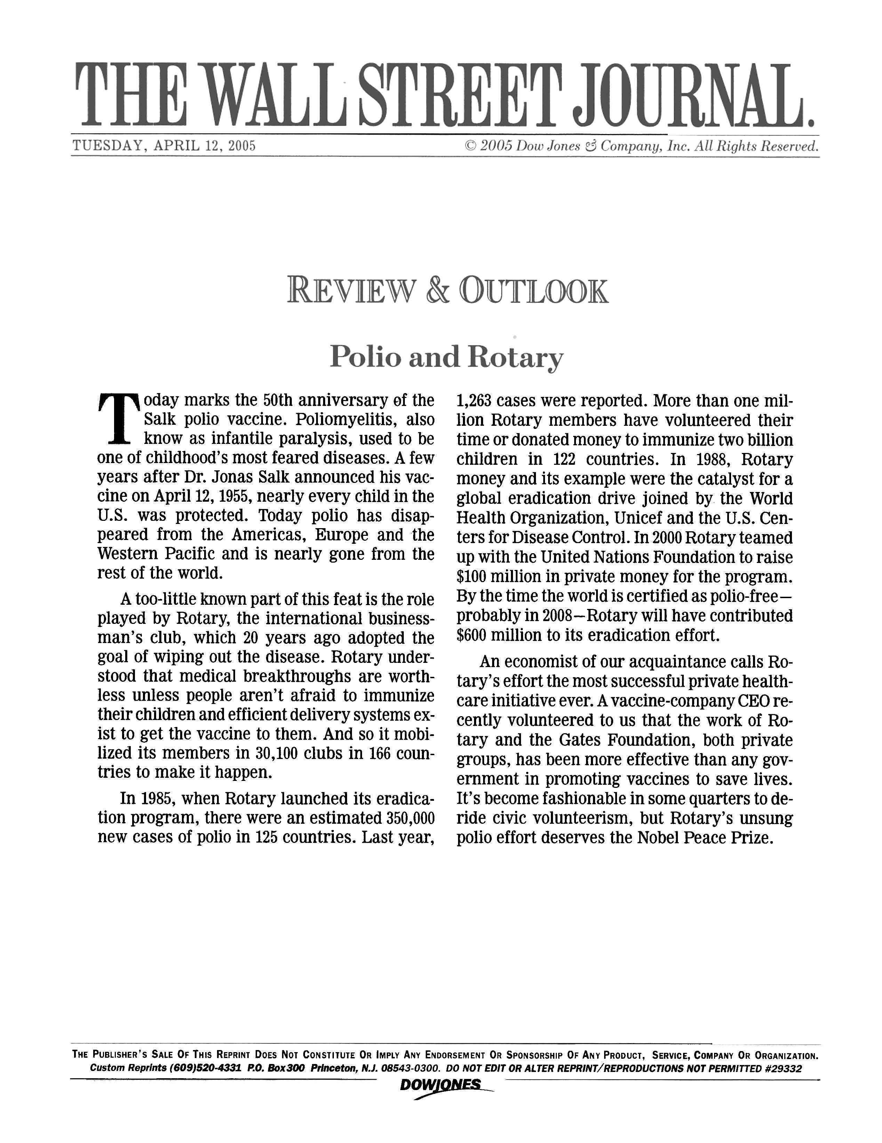
Rotary’s PolioPlus effort deserves the Nobel Peace Prize.

Slide 17
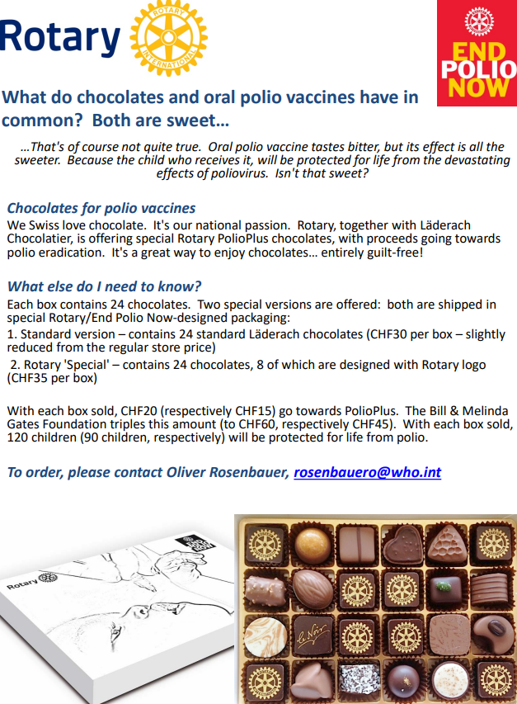

Slide 18


Slide 19
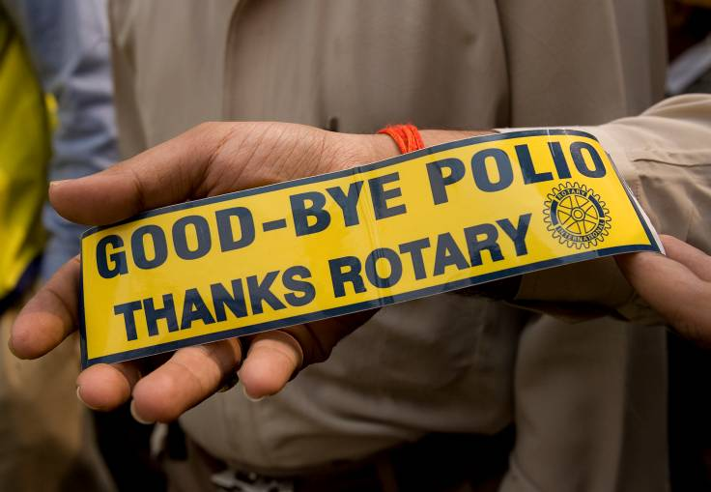
www.polioeradication.org

